Slide 1
Operating Systems & Applications

Slide 2
Chapter Objectives
By Completing this chapter, you should be able to:
Understand the basics of operating systems.
Understand the main functions of an OS.
Define the term Filesystem and identify the file metadata, permissions, and attributes.
Understand the file and directory operations.
Understand the hardware representation of data.
Define the term application and distinguish between the main types of applications.
Understand the basics of software installation.

Slide 3
Topics
Basics of Operating Systems.
Functions of an OS
Filesystems.
Understanding Applications.
Types of applications.
Single-platform vs. cross-platform applications.
Managing applications.
Basics of Software Installation.

Slide 4
Basics of Operating Systems
The Operating System (OS) is system software that manages the basic functionalities of a computer and is responsible for tasks such as process management, memory management, file system management, IO management, networking, security, and providing a user interface.
Every computer contains at least one operating system which starts working the moment a computer is turned on.

Slide 5
Basics of Operating Systems
The OS has control over both the software and hardware resources of a computer.
At the core of an operating system is the kernel which manages all the interactions between the hardware and software components of a computer.

Slide 6
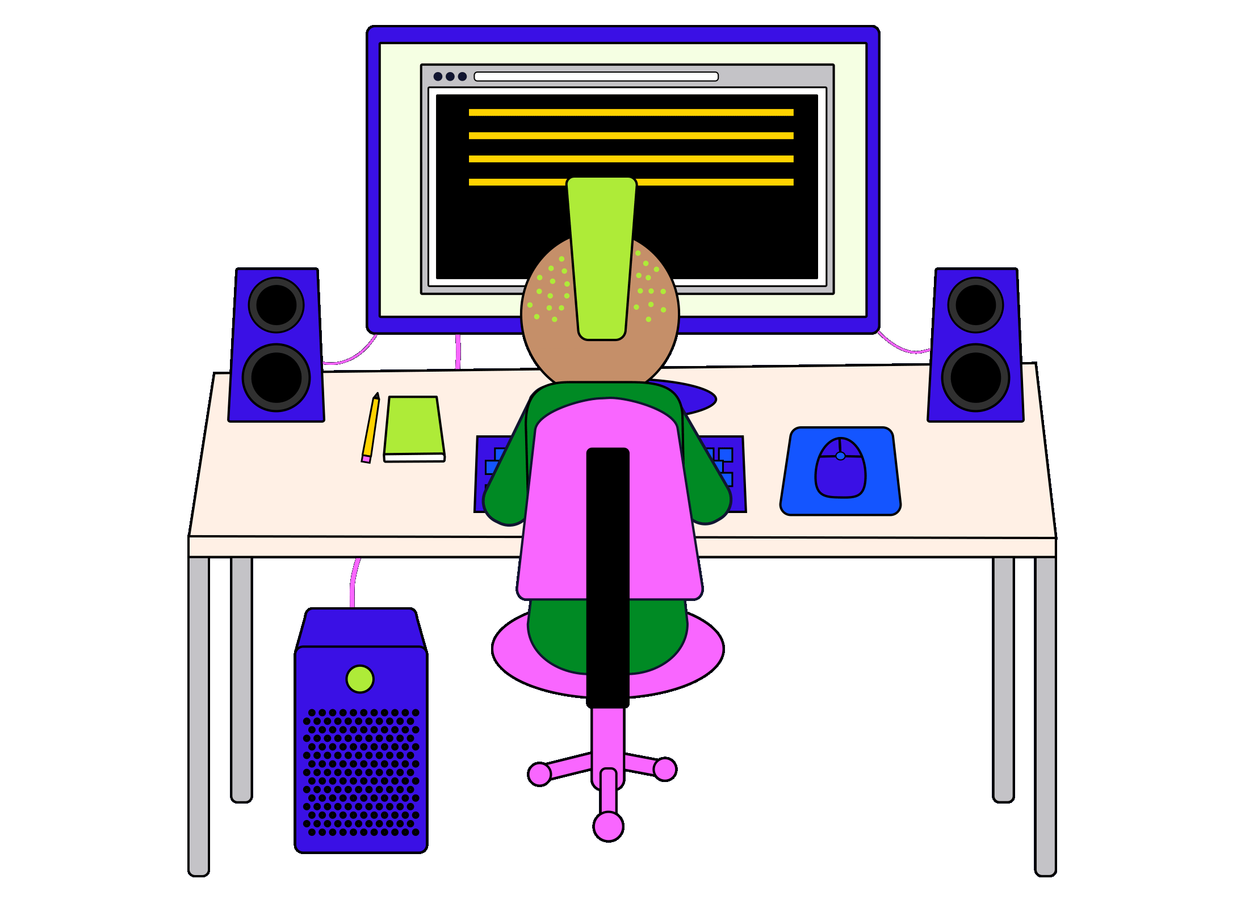
Introduction to Operating Systems
The process of interacting with our computers to do the activities often seems easy from our perspective. The truth is, these tasks are quite complicated from the perspective of our computers. Let’s discuss this task:
“Use our mouse to open up our favorite music application and turn up our speakers to enjoy our favorite song”.

Slide 7
Introduction to Operating Systems
For our computer to accomplish this task, it needs to:
Handle the input of mouse movement and mouse clicks.
Fetch the data necessary to run the software responsible for the music application.
Run that software.
Retrieve the data necessary to play a specific song.
Communicate with the speaker to output this song.
Handle the input of the speaker dial being turned.
Communicate with the speaker to output the music at a louder volume.
That’s a lot of work being done in just a few seconds! Lucky for us that, as users, we don’t have to think about any of this. The responsibility of handling tasks like this falls on the operating system.

Slide 8
What is an operating system?
An Operating System, or OS, is system software that’s responsible for handling the basic functionalities of a computer. Some examples of popular OSs are:
Windows
Linux
Mac
Android
iOS
Some of the vital functions of an OS:
Process Management
Memory Management
File Management
IO Management
Multitasking
Networking
Security
Providing a user interface

Slide 9
Functions of an OS
Process Management
Our computers run a lot of software. Word processing documents, internet browser, a spreadsheet document, video games - all of these are examples of software. But how does the software know what to do? - computer programs! Computer programs contain specific instructions that dictate how a program should work when they’re run.
When we run a program, the instance of that execution is represented by a process. Operating systems handle the responsibility of managing active processes.

Slide 10
Functions of an OS
Memory Management
We utilize a significant amount of memory in order to store data in our computers; however, not all data is treated the same! Some data, like pictures, need to be stored permanently. Other data, like the information we need to run a process, only needs to be stored temporarily while the application is in use. This temporary memory is known as primary, or main, memory. While hardware like hard disks are used to store permanent data, the operating system is responsible for the management of primary memory stored in RAM.

Slide 11
Functions of an OS
File System Management
If we store any file, in a folder on our computer, we are utilizing our computer’s file system. The operating system manages information about individual files as well as the directories they belong in.
The OS is also responsible for maintaining file systems by being able to perform tasks such as creating, deleting, renaming, and copying files and/or directories.

Slide 12
Functions of an OS
IO Management
IO stands for Input/Output and represents the devices used for interaction.
A mouse is considered an input device, because we use them to send data to our computer.
A monitor is regarded as an output device since it is used to communicate data (like an image) to us, the user.
The operating system plays a large role in managing IO by ensuring communication between IO hardware and IO software

Slide 13
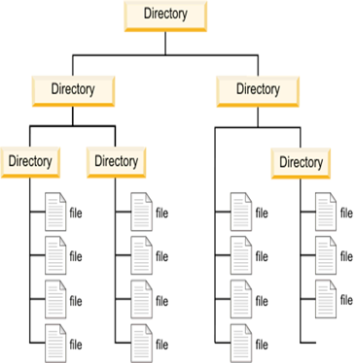
Filesystems
The filesystem is the data structure used by the operating system to store and retrieve data.
Allows developers to manipulate data without having to be concerned with the minutiae of how each storage device works.
Notes:
Whether it is playing music, looking at photos, or watching a movie, computers are responsible for holding a lot of data. Having this data be stored safely in an efficient way is critical for the operation of any computer and the filesystem is the component within the operating system that handles this.
The filesystem is the data structure used by the operating system to store and retrieve data. This is a software abstraction that allows developers to manipulate data without having to be concerned with the minutiae of how each storage device works.

Slide 14
Filesystems
A file is a unit of storage used to describe a self-contained piece of data and can have a variety of possible formats based on what that file contains.
File format is indicated by the file’s extension that follows the file’s name.
Some common extensions and their file types:
.txt for text files
.doc for Microsoft Word files
.jpg for image files encoded using the JPEG compression algorithm

Slide 15
Filesystems
The files are organized into directories.
A directory is a data structure that contains references to files and other directories.
The directories are typically organized in a hierarchical tree structure called a directory tree.
A working directory, also called a current directory, is the directory associated with the execution of a process.

Slide 16
Filesystems
File Metadata, Permissions, and Attributes
The files do not contain crucial data only, but also some metadata will be stored in order to manage these files.
The file control block holds all of this metadata for the file, including file permissions, owners, sizes, and create, modified, and access times.
File attributes are a collection of metadata that determine how files behave, such as if they are hidden or compressed.
File permissions determine which users and groups can read, write, and execute the file.

Slide 17
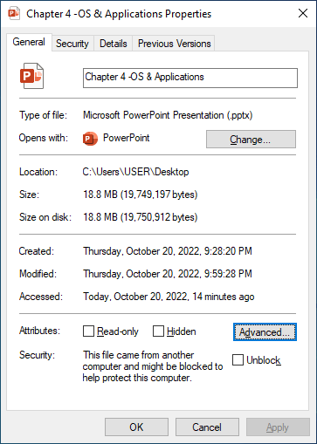
Filesystems
File Metadata, Permissions, and Attributes
files can also have attributes that indicate special behavior. While this differs on the operating system, common attributes include:
Hidden: Cannot be viewed by default in file managers.
Immutable: Cannot be modified.
Compressed: The file is in a compressed form to save space.

Slide 18
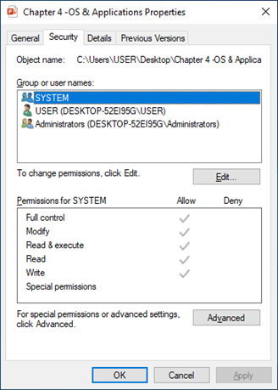
Filesystems
File Permissions Overview
Within the file permissions are controls for the three main actions that can be performed on a file: Reading, Writing, and Executing.
The permissions differ by the user as well as collections of users called groups.

Slide 19
Filesystems
File Permissions Overview
In Unix operating systems, the permissions for a file are represented using a line of 10 characters. The first character can either be - for a file or d for a directory. The other 9 characters are separated into three equal parts called triads.
Each of these three characters within a triad are flags indicating a permission.
r means that the file is readable, w means that the file is writable, and x means that the file is executable.

Slide 20
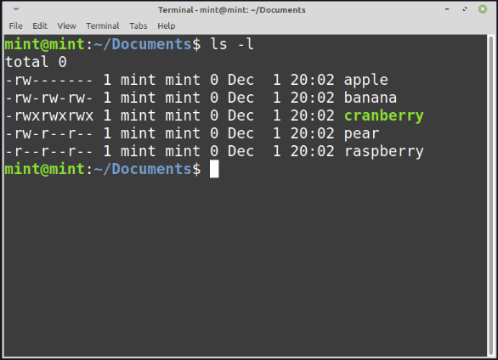

Slide 21
Filesystems
File Permissions Overview
The first triad containing the first three characters contains the permissions for the owner, the second triad contains the permissions for the group, and the third triad contains the permissions for any other user outside of this.
Each of these three characters within a triad are flags indicating a permission. r means that the file is readable, w means that the file is writable, and x means that the file is executable.

Slide 22
Filesystems
File Permissions Overview
To the right is a directory from a Linux operating system showing the permissions for a variety of files:
For apple, -rw------- means that the file is readable and writable for only the owner.
For banana, -rw-rw-rw- means that the file is readable and writable for all users on the system. https://youtu.be/7hTasN9pSvI

Slide 23
Filesystems
File Permissions Overview
For cranberry, -rwxrwxrwx means that the file is readable, writable, and executable for all users on the system.
For كمثرىpear, -rw-r--r-- means that the file is readable and writable for the owners, but only readable for everybody else.
For raspberry, -r--r--r-- means that the file is read only.توت العليق

Slide 24
Filesystems
Hardware Representation of Data
Within a hard disk drive is a spinning platter with a thin magnetic coating.
A pointy head that looks like a thin fountain pen moves over this platter to etchحفر data into the platter by adjusting the direction of the magnetic field at an incredibly precise location.موقع دقيق
The smallest chunkجزء of this physical storage is called a sector.
يوجد داخل محرك الأقراص الثابتة طبق دوار بطبقة مغناطيسية رقيقة. يتحرك رأس مدبب يشبه قلم حبر رفيع فوق هذا الطبق لحفر البيانات
في الطبق عن طريق ضبط اتجاه المجال المغناطيسي في موقع دقيق بشكل لا يصدق.
أصغر جزء من هذا التخزين المادي يسمى قطاع.
Notes:
As data is the cornerstone of how a computer operates, discussing its physical representation is crucial to best understanding it. What does it look like in the real world when a file is saved onto a hard drive?
For this discussion we will focus mainly on the spinning metal hard disc drive, as most of the design choices for filesystems were based on their inclusion and they are still the most prevalent form of data storage, especially in servers.

Slide 25
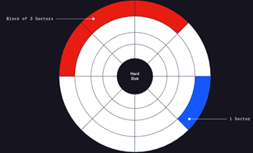
Filesystems
Hardware Representation of Data
Smaller sectors require more information to index the entire drive, like a librarianفهرسة trying to organize millions of small pamphlets.كتيبات
This ruins اثارperformance for finding files as well as creates substantial overhead for documenting the location and content of each sector.
Notes:
In the image on the right, a sector is shown as a small region on a hard disk drive, while a block is a collection multiple such sectors.

Slide 26
Filesystems
Hardware Representation of Data
However, larger sector sizes also have drawbacks. For example, if saving a file that has a size of 512 bytes and the sector size is 4096 bytes, the entire sector is written and used, effectively wasting 3584 bytes of space
This is abstracted further in the software filesystem, where blocks are used to represent groupings of sectors.
This is used as an abstraction so that the operating system and all of the applications that reside on it can have a common block size to target instead of needing to accommodate whatever arbitrary sector size is chosen by the hardware manufacturer.

Slide 27
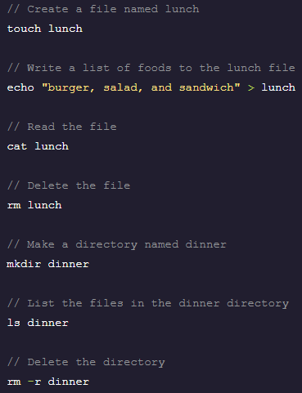
Filesystems
File and Directory Operations
Both files and directories can be created, opened, read, written, deleted, closed, linked, unlinked, listed and truncated.
It is possible to move across directories as well as find files within directories.

Slide 28

Understanding Applications
What is an application?
An application (or “app”) is a computer program that performs a certain task. You’re using an app right now to read this! A PowerPoint is just one of the many apps you have on your computer.

Slide 29
Understanding Applications
What is an application?
Nearly everything you do on a computer involves an app. Want to type a letter? The word processor is an app. Need to join a meeting? Zoom and Skype. Need to access the Settings? That’s an app, too! teams
The role of the computer itself is to make sure users can use apps securely and efficiently. Imagine your computer wasn’t able to open a word processor, a web browser, and the calendar app at the same time.

Slide 30
Understanding Applications
Types of applications
There are many different types of apps, and some can fit into multiple categories.
Main applications categories:
Productivity applications.(pdf)
Collaboration applications.( teams, zoom, google class, email, games)
Business applications.(Dss,accounting).

Slide 31
Types of applications
Productivity applications.
Productivity apps allow users the ability to perform daily tasks and engage with information in an efficient way.
A word processor is considered a productivity app. A lot of time is saved by typing documents on a word processor rather than a typewriter.
A web browser is a productivity app too as it is much faster to search a term online rather than page through an encyclopedia.( ChatGpt&wiki)

Slide 32
Types of applications
Collaboration applications.
These apps help people work together and communicate in an efficient way.
Email and video-conferencing applications would fall into this category.

Slide 33
Types of applications
Business applications.
Apps in this category revolve around certain business needs.
Included here might be a stock-trading app, an accounting app, or a supply-chain management app. حلقات التصنيع

Slide 34
Single-platform vs. cross-platform applications
Depending on the app, though, it may or may not be able to run on multiple operating systems.
An app that can only run on Windows, for example, is a single-platform app because it cannot also run on Mac or Linux.
An app that can run on multiple operating systems is called a cross-platform app.

Slide 35
Managing applications
Viewing a running application
Being able to determine which apps are currently running is critically important to IT.
Sometimes apps will operate in the background.
Between foreground and background apps, you can sometimes lose track of all the apps you’re running. When too many apps are open, our computer can slow down as its hardware fights to keep up with all the requests.

Slide 36
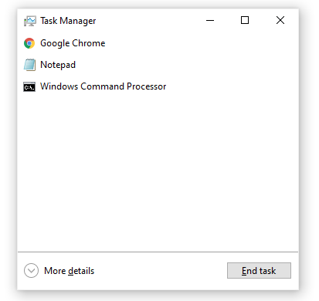
Managing applications
Viewing a running application
Your computer provides an accessible way to see which apps are running at a given time.
To view running apps, press CTRL + ALT + DELETE. Once you do this, you will see a screen with a variety of options. Click Task Manager. You should now see a window with a number of currently-running apps.

Slide 37
Managing applications
Killing an application
Sometimes, an error may occur and an app stops responding to your computer. When this happens, you will not be able to interact with the app until it starts responding again. But since you may be waiting indefinitely, you may just want to force the app to close so that you can relaunch it.
To kill an app, open Task Manager, click on the name of the app you wish to close, and then click End Task.

Slide 38
Basics of Software Installation
Your computer comes with a ton of built-in software programs such as note-taking applications, a virtual calculator, photo-viewing programs, and more.
What happens when you want to use a piece of software that did not come with your computer? You must install it.
Installing a program means configuring your computer so that it can run a specific program. تجهيز وتنظيم

Slide 39
Basics of Software Installation
It is impossible to use a piece of software without first installing it.
A piece of software is installed when all of its files are placed in a folder on your computer and an executable file — an entry-point for starting and running the software — is generated.
Knowing how to download and install software on your computer is a critical skill for anyone interested in IT.

Slide 40
General installation steps
Downloading software
To use a piece of software, you must first download it.
Downloading means retrieving files and data that make up the software from the internet (stored on a server somewhere) and storing them on your local computer.
Most downloads will take place over the internet. Make sure that you are careful from which websites you download files.
A majority of viruses and malware come from downloads from malicious sources online, so be sure to use only trusted sources.

Slide 41
General installation steps
Installing software
At this point, the remainder of the software installation process is highly dependent on the operating system.
Broadly speaking, you will use the installation file you downloaded to install the software; however, the form that file takes will depend on your operating system.
Downloading some pieces of software will require you to accept certain terms and conditions.

Slide 42
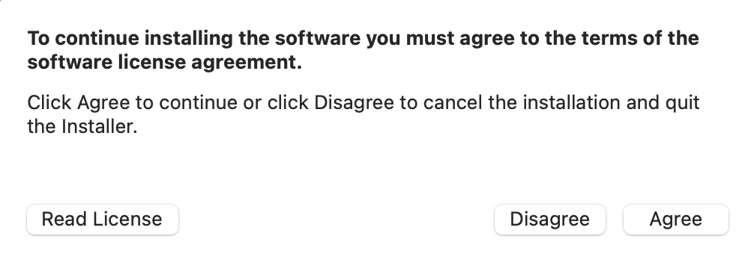
General installation steps
Installing software
These spell out a number of very important policies which will tell you what you can expect in aspects such as data privacy.
The terms and conditions may be lengthy, but they provide critical information.
As a professional in information technology (IT), it’s important to understand the terms of use of a piece of software..

Slide 43
Wrapping up
The operating system (OS) is system software that manages the basic functionalities of a computer.
Some of the tasks that an OS is responsible for are process management, memory management, file system management, and IO management.
Filesystems are the data structure used by operating systems to store and retrieve data.
Certain apps can work on more than one operating system while others cannot. The ones that cannot are called single-platform apps; the ones that can are called cross-platform apps.
Knowing how to download and install software on your computer is a critical skill for anyone interested in IT.

